Slide 1
PoP 101
Revised December 2020

Slide 2
PoP 101
ANSWERS TO YOUR MOST-ASKED QUESTIONS:
What constitutes a PoP
How do PoPs begin?
What makes a valid PoP?
How is Entering EFL established?
How are Measurable Skills Gains generated?
How do you end a PoP?
What about students who are in multiple programs in the same PoP?
What about students who carry over from one fiscal year to the next?

Slide 3
What is a period of participation?

Slide 4
What is a Period of Participation?
All participants have at least one period of participation, starting with their first enrollment in the program year and ending with their program exit. Subsequent periods are counted by reentry and exit. The exit date is the last day of service for participants, but this date cannot be determined until 90 days have elapsed since the person last received services and there are no future services planned. However, if there is no exit across a program year, the PoP continues into the next program year and MSG is reported for the new program year.
https://nrsweb.org/sites/default/files/NRS-TA-January-2018-508.pdf

Slide 5
What makes a period of participation valid?
At least one
At least twelve
Approved NRS Registration
Approved Assessment
- Or -
a Provisional Entering EFL established!
Approved Hours of Attendance

Slide 6
What happens if the PoP doesn’t meet the minimum standards?
At least one
At least twelve
Approved NRS Registration
Only 10 Hours
Approved Assessment
- Or -
a Provisional Entering EFL established!
Approved Hours of Attendance

Slide 7
For the purposes of federal tables 1, 2, 3, 4, 4A, 4B and 4C the Pop is treated as if it never existed
POP didn’t meet hours or test minimums
PoP didn’t meet the minimum
Student assessments aren’t considered for inclusion on the Federal Tables
Attendance Hours are not counted toward the student total

Slide 8
When a PoP doesn’t meet the criteria for inclusion on federal tables
TABLE 2A 2A
See the Reporting Powerpoint for details

Slide 9
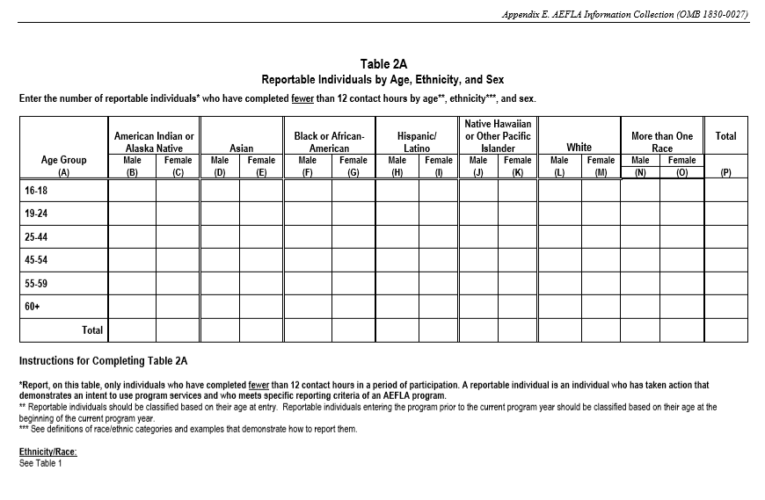
TABLE 2A
NOTE:
TABLE 2A is identical to Table 2 except it only considers students who DID NOT have a valid Period of Participation in the Fiscal
Rules for Gender and Ethnicity carry forward from Table 1.
NOTE:
Age is based on the first CONTACT DATE
* This is different from Table 2, which is based on registration!
An individual who has taken action that demonstrates an intent…
NOTE:
Students with one or more VALID PoP in a Fiscal Year will not be considered for Table 2A even if one or more PoPs in that fiscal do not meet the minimum standards.

Slide 10
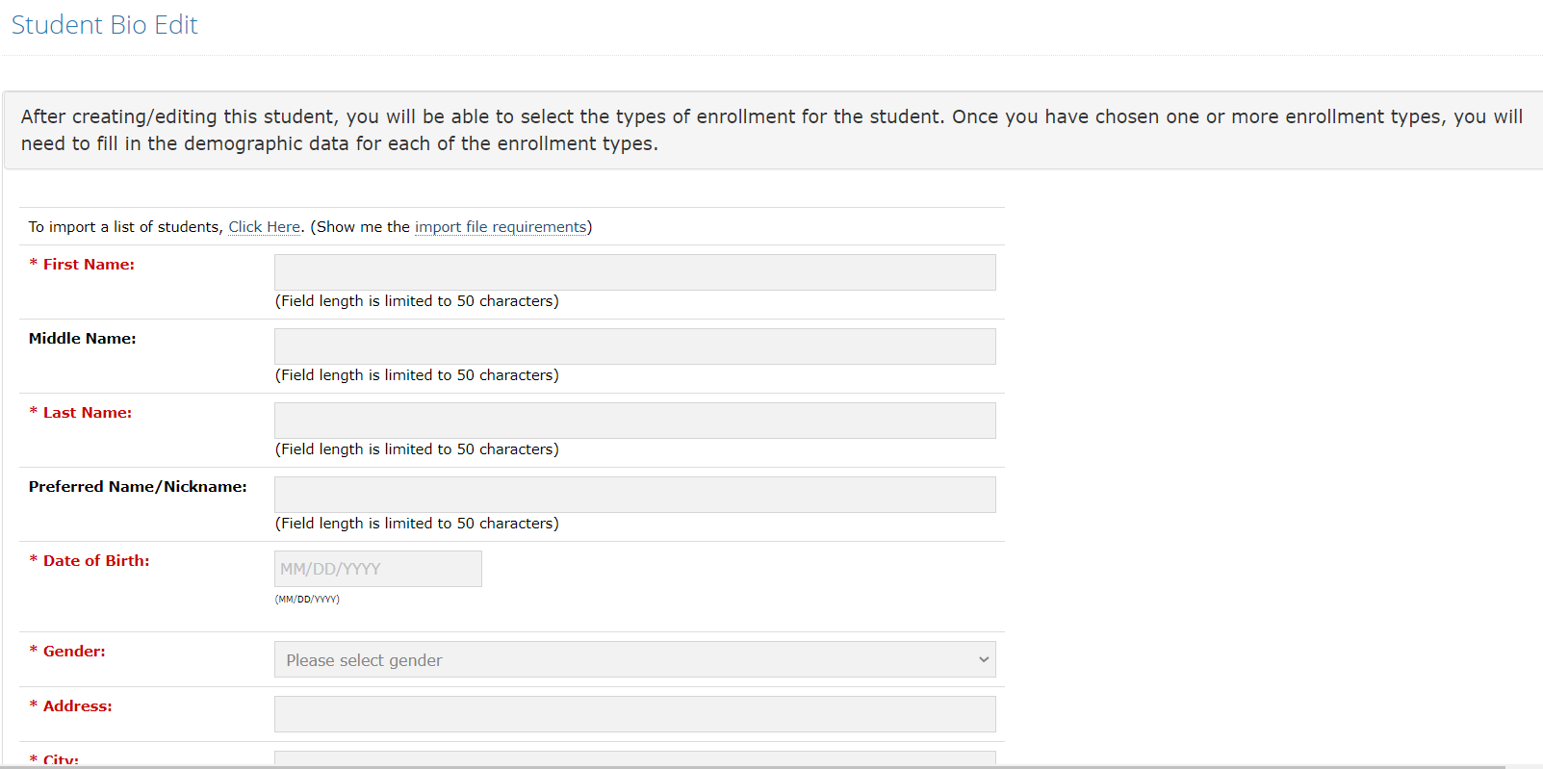
TABLE 2A
Information from the student bio page is used to complete Table 2A. Any student who completes this section, is eligible to appear on this federal table

Slide 11
How are periods of participation managed?

Slide 12
When does a Period of Participation Begin?
For new students or the first NEW PoP in a fiscal year, the date of the first registration in the fiscal year is the start date of the Period of Participation
We will deal with students who transition from one year to the next later in this presentation

Slide 13
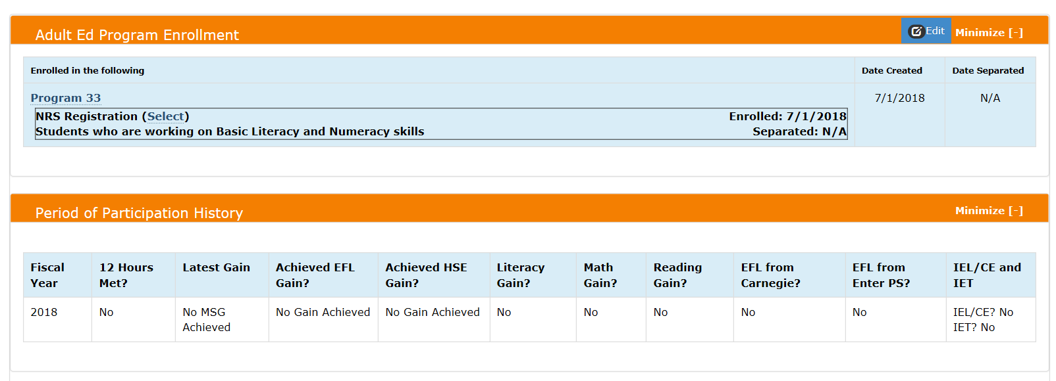
When does a Period of Participation Begin?
The NRS Registration date (NOT THE CREATED DATE even though the two may be the same) is the key to determining the beginning a student’s PoP.

Slide 14
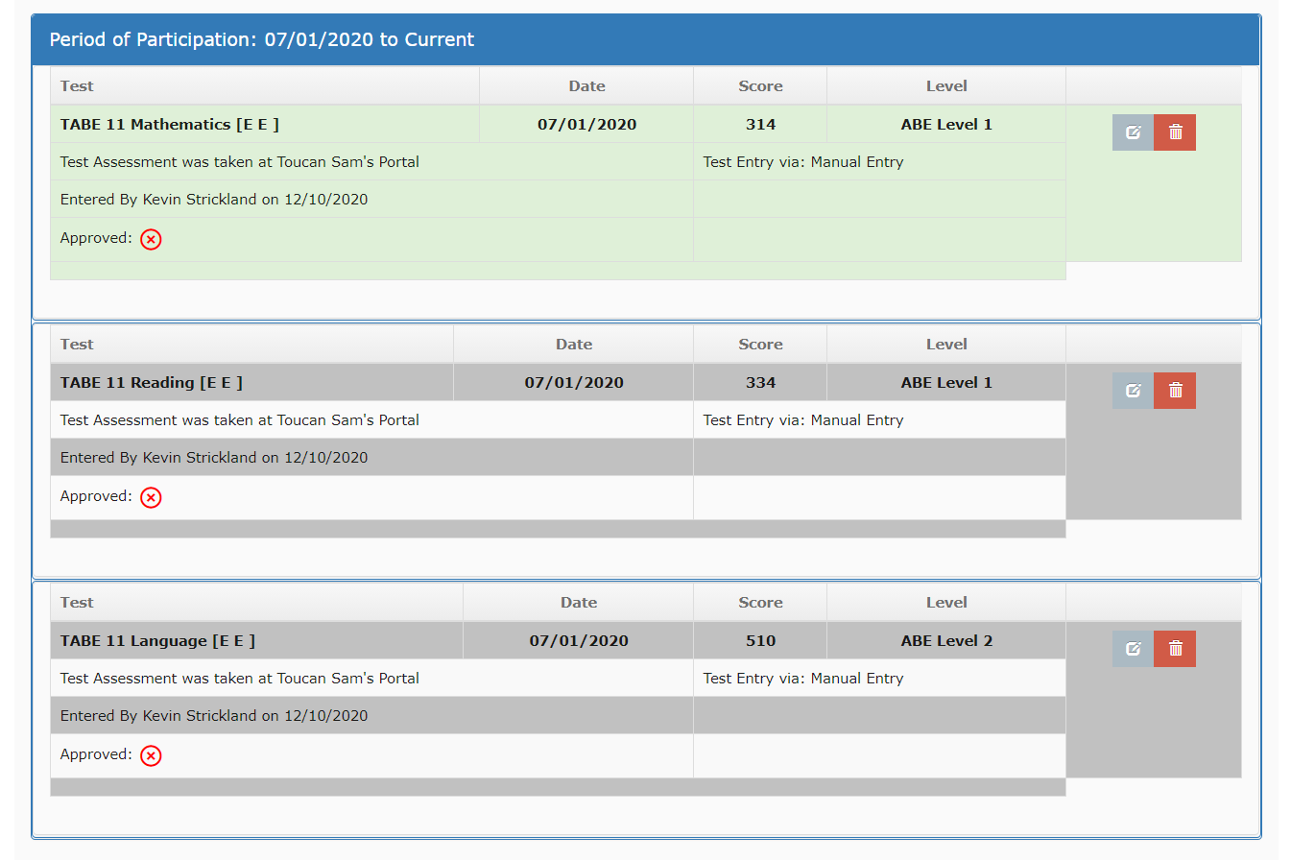
Establishing a Student’s entering Educational Functioning Level - EFL (BY ASSESSMENT)
For new students or the first NEW PoP in a fiscal year, the pre-tests for the student establish the Entering EFL based on the lowest score of the first approved tests of the fiscal.
The assessment that creates the Entering EFL will be highlighted in green.

Slide 15
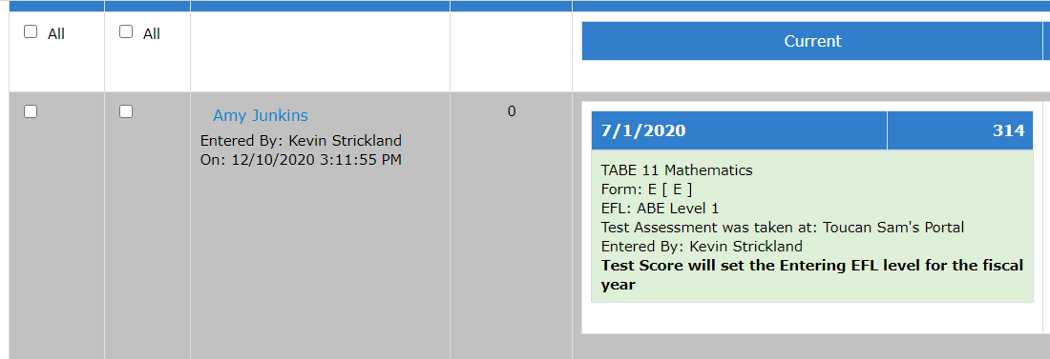
Establishing a Student’s entering Educational Functioning Level - EFL (BY ASSESSMENT)
A message on the Approvals page associated with the first assessment of a Period of Participation in a fiscal year will indicate that approving the assessment will establish the Entering EFL for the student.
This applies to the first PoP of a fiscal year in which the student does not roll over from one year to the next. We will discuss students who roll over later in this presentation.

Slide 16
Testing after the Entering EFL has been Established
In the above example, if the TABE 11 Mathematics Test is approved, the student’s Entering EFL will be established as ABE Level 1.

Slide 17
Testing after the Entering EFL has been Established
IMPORTANT: The Entering EFL persists for the entire Fiscal Year, even if the student has a second or third PoP!

Slide 18
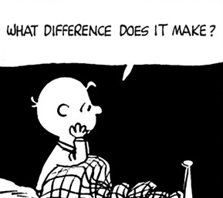
Why does the Entering EFL matter?
Entering EFL establishes where the student is slotted on Federal Tables 1, 2, 3, 4, 4A, 4B and 4C
Entering EFL establishes the bar for achieving a Measurable Skills Gain. If a student’s Entering EFL is at Level 2, the student cannot revert to Level 1 and return to Level 2 in the same subject area and qualify for a MSG.

Slide 19
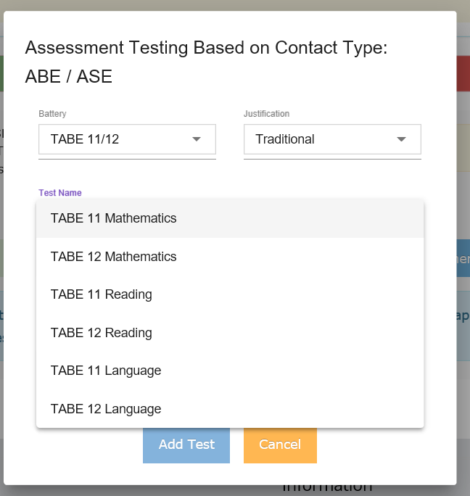
Testing after the Entering EFL has been Established
Once the Entering EFL has been established, all available assessments in the selected battery will be available.
In the example, the student established the Entering EFL as ABE Level 4 with an approved TABE 11 Math test.
At that point, the available tests for that battery are:
TABE 12 Math
TABE 11 – 12 Reading
TABE 11-12 Language

Slide 20
Testing after the Entering EFL has been Established
Once the Entering EFL has been established, all available assessments in the selected battery will be available.
The entry of any of the available tests will NOT impact the Entering EFL.
Entering a TABE 11 or 12 Reading or TABE 11-or 12 Language will establish the threshold for that subject area in the calculation of Measurable Skills Gains

Slide 21
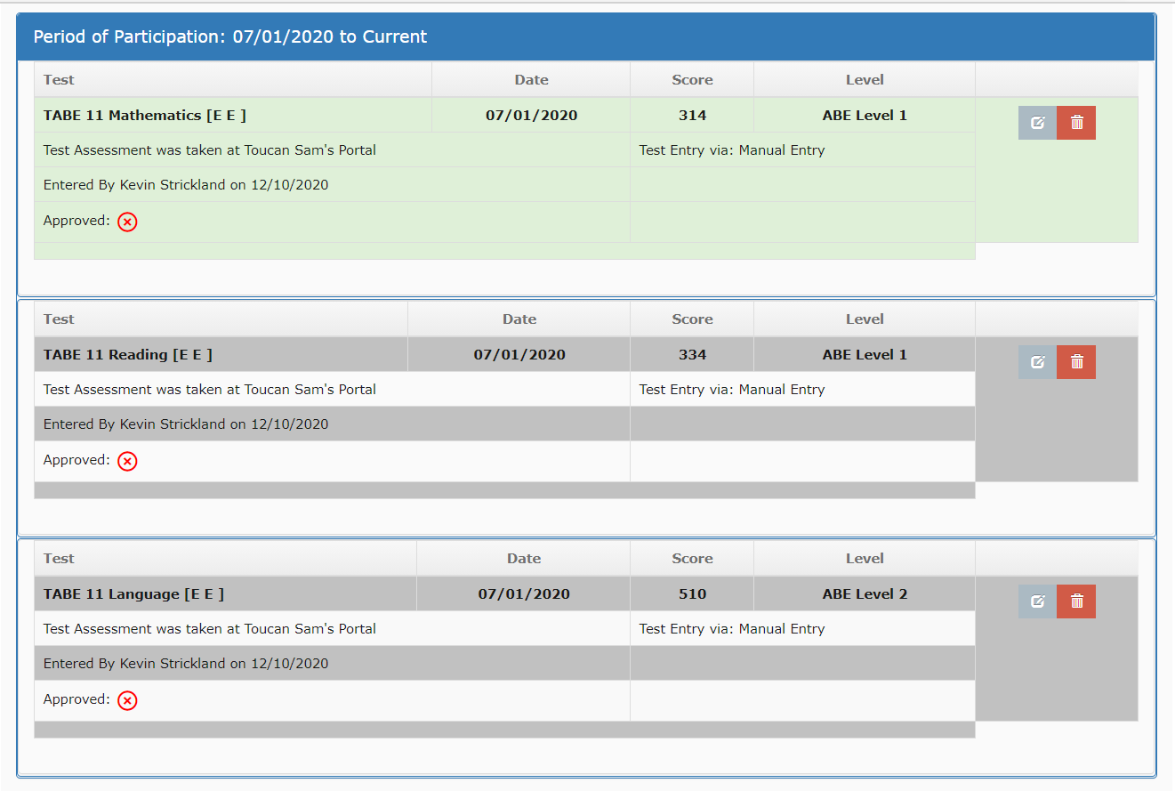
Generating a measurable skills gain
Measurable Skills Gains are determined on a subject area by subject area basis.
In this example, a level improvement in any of the three subject areas will be sufficient to generate a Measurable Skills gain
ADD SOMETHING HERE!

Slide 22
Generating a measurable skills gain
Improvement Requirements display the scores needed to achieve a level gain in each tested subject area.

Slide 23
Generating a measurable skills gain
Remember that to generate a MSG the improvement must be higher than the initial threshold level for that particular subject area!
Example: Starting at Level 3, regressing to Level 2 and returning to Level 3 is NOT sufficient to qualify for a MSG

Slide 24
How does a pop end?
A Period of Participation Ends when there has been no activity on the student’s record for at least 90 days
-- AND –
No future services are scheduled.
Approved NRS Registration

Slide 25
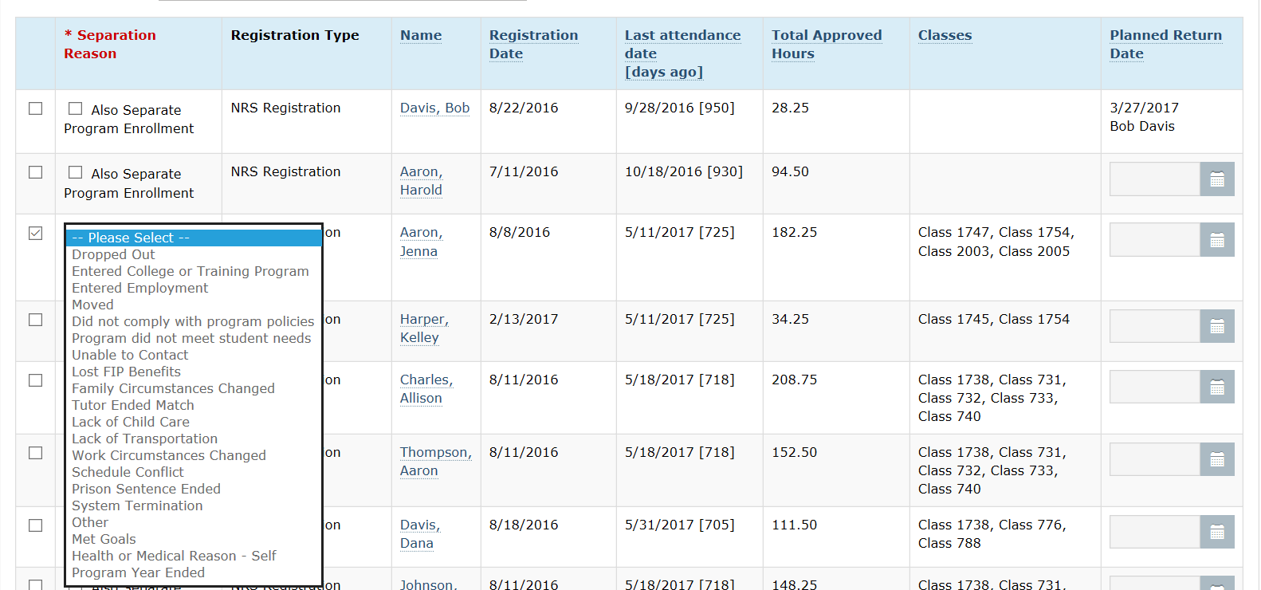
How does a pop end?
A Period of Participation Ends when there has been no activity on the student’s record for at least 90 days
-- AND –
No future services are scheduled.
Use the NRS Separation Report to find students who haven’t had any activity for 90 days and are due for separation.
Students may be separated directly from this screen or a planned return date may be entered.
NOTE: The planned return date can be no more than 180 days from the date of last activity!

Slide 26
How does a pop end?
A Period of Participation Ends when there has been no activity on the student’s record for at least 90 days
-- AND –
No future services are scheduled.
When separating a student from the program while using the NRS Separation Report, please choose the appropriate reason for leaving from the provided dropdown!
Pay particular attention to the values marked as “Excludes” in the choices

Slide 27
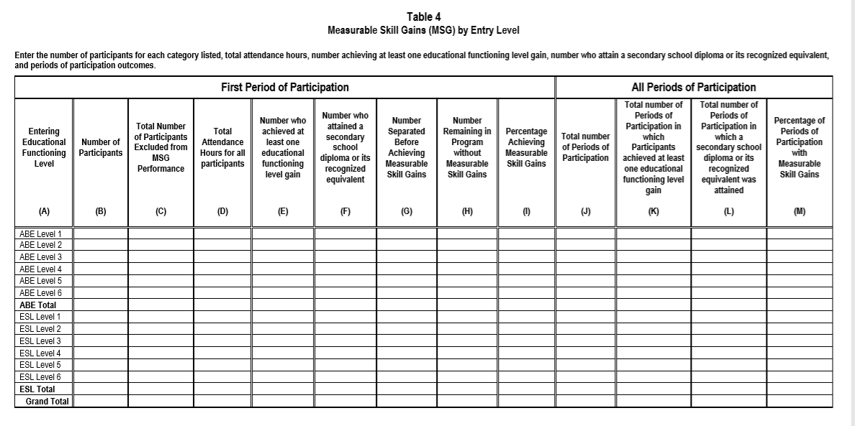
Ending a PoP
Reason for Leaving and Excluding Students from Table 4
When separating a student from the program while using the NRS Separation Report, please choose the appropriate reason for leaving from the provided dropdown!
Column C on Table 4 now tracks students who are EXCLUDED from being considered for MSG Performance.

Slide 28
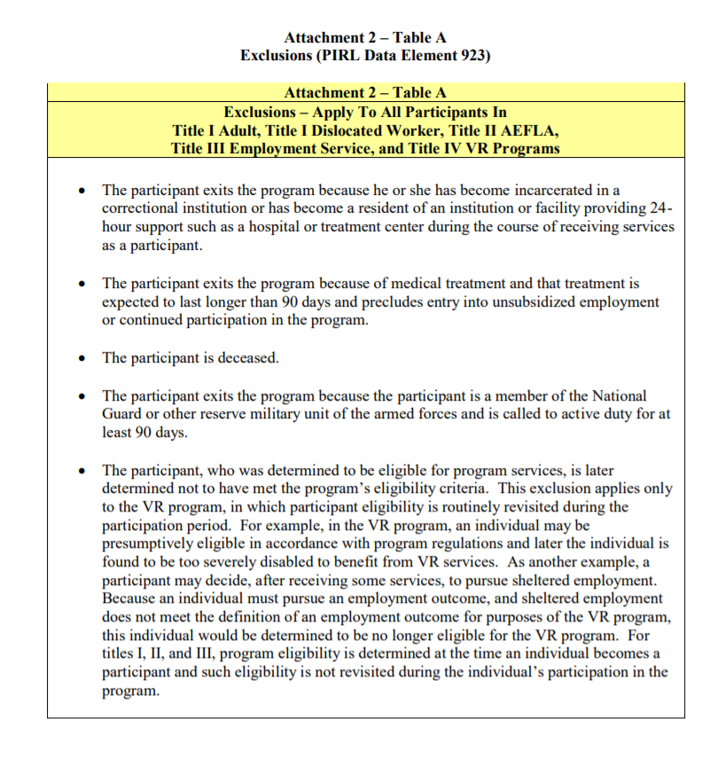
Ending a PoP
The number in Column C is the number of participants being excluded from MSG performance due to the exclusion scenarios listed in OCATE Program Memorandum 17-2, Attachment 2, Table A. No values associated with these participants should be entered into Columns E-G.
Reason for Leaving and Excluding Students from Table 4
EXCLUSIONS SHOULD BE RARELY USED!
https://www2.ed.gov/about/offices/list/ovae/pi/AdultEd/octae-program-memo-17-2.pdf
NOTE: Column C applies to the student’s first valid period of participation ONLY!

Slide 29
Ending a PoP
Reasons for Leaving that qualify as exclusions will be found in the dropdown for Separation Reasons both in the NRS Separation Report and the individual student separation process.
These reasons will be marked as “Excludes from Table 4”
Reason for Leaving and Excluding Students from Table 4

Slide 30
How does a pop end?
Automatic Separation
On the 180th day of inactivity, Benchmark ITS runs a process in the background that automatically separates students and establishes the separation date as the last day of activity (assessment or attendance).
At that point, all registrations with 180 days or more of inactivity are separated in a single “snap.” It is inevitable.

Slide 31
Why not just wait for the “finger snap” of automatic separation?
Processing student separations from the NRS Separation Report gives programs control over their data.
Automatic separations are given generic Reasons for Leaving, marked as “auto separated”
Consistently managing students on the NRS Separation Report keeps it from becoming unwieldy
Consistently managing students on the NRS Separation Report helps keep fluctuations on Federal Reports from varying dramatically

Slide 32
Multiple PoPs, multiple enrollments and continuing students
And the answer to your biggest question, who gets the MSG?

Slide 33
When is a pop a second pop?
When a student separates from ALL registrations, the student should logically have been inactive for at least 90 days.
If the student returns for additional instruction during the same fiscal year, a second Period of Participation is created.
Second PoPs are typically rare!

Slide 34
What are the rules for a second pop?
PoP One
PoP Two
* Must have a registration date at least 90 days since the last activity in the first PoP
* Must have NRS Registration
* Must have at least one approved test
* Must have at least 12 hours of approved attendance
* Is not required to consider tests in prior PoP
90 Days

Slide 35
What about STUDENTs IN MULTIPLE PROGRAMS IN THE SAME Period of participation?
Program A
Program B

Slide 36
What about STUDENTs IN MULTIPLE PROGRAMS IN THE SAME Period of participation?
Program A
VALID PoP
Rules to create a valid PoP remain essentially the same:
Must have an NRS Registration (in both programs)
Must have a combined total of 12 hours
Must have at least one assessment in the Period of Participation – or – an established Provisional Entering EFL
Program B

Slide 37
What about STUDENTs IN MULTIPLE PROGRAMS IN THE SAME Period of participation?
Program A
VALID PoP
For a student to appear on the report population for a Program, that student must:
Have at least one Assessment in the Period of Participation (at either program)
Be placed in a class in that program
Have at least one hour of approved attendance in that program
Program B

Slide 38
What about STUDENTs IN MULTIPLE PROGRAMS IN THE SAME Period of participation?
Program A
Testing
Either Program can start a battery of tests.
Either program may switch between assessment types.
Assessments are tied to the student, not the program!
Program B

Slide 39
What about STUDENTs IN MULTIPLE PROGRAMS IN THE SAME Period of participation?
Program A
Pre-Test
Program A tests student in July in TABE 11 Math at Level 2 and TABE 11 Language at Level 3.
Quiz: What is the Entering EFL?
Program B
Post-Test
Program A OR Program B can subsequently test student in TABE 12 Math, TABE 12 Language and/or TABE 11 or 12 Reading.

Slide 40
Who gets credit for the measurable skills GAIN?

Slide 41
Who gets the GAIN?
Assuming the student qualified as valid in the Period of Participation for both programs, when the student achieves a Measurable Skills Gain, that achievement is recognized for BOTH programs – no matter which program entered the assessments.

Slide 42
Separating students in multiple enrollments
Program A
In a situation where a student is enrolled in more than one program, each program manages its own registration, but the Period of Participation is maintained by the system. The PoP does not end until all registrations associated with it are ended.
In the example to the left, the Period of Participation begins in July 2020 with the registration in Program A.
The student is last active in Program A in November and would appear on the NRS Separation Report for Program A in March 2021 at which time he/she would be separated with an effective date in November 2020.
The student attended Program B in October and continued through February of 2021 This student would appear on the NRS Separation Report for Program B in June 2021 at which time he/she would be separated with an effective date in February 2021.
Registered July 2020
Last Active Nov. 2020
Program B
Registered Oct. 2020
Last Active Feb 2021
What are the beginning and end dates of the PoP for this student?

Slide 43
Separating students in multiple enrollments
Program A
NOTE:
There may be instances where a program’s interaction with a student ends prior to the beginning of that student’s interaction with another program, so long as there is no 90-day gap between the end of one registration and the beginning of another.
Registered July 2020
Last Active Aug. 2020
Program B
Registered Oct. 2020
Last Active March 2021
What are the beginning and end dates of the PoP for this student?

Slide 44
Managing rollover students
Although Federal Reports adhere to a fiscal year that begins July 1 and ends June 30, the practical day-to-day administration of programs typically has no clear-cut dividing line.
With Period of Participation rules in place, it is a frequent occurrence that students will carry over from one fiscal year to the next.
Your system is designed to handle that behind the scenes. You are NOT required to separate students at the end of the fiscal. In fact, this practice is discouraged.

Slide 45
Activating A period of Participation in a New Fiscal
If the Period of Participation rolling over is active, a single hour of attendance in the new fiscal is sufficient to activate the Period of Participation.
If the Period of Participation was NOT active, the qualifications must be completed in the new fiscal.

Slide 46
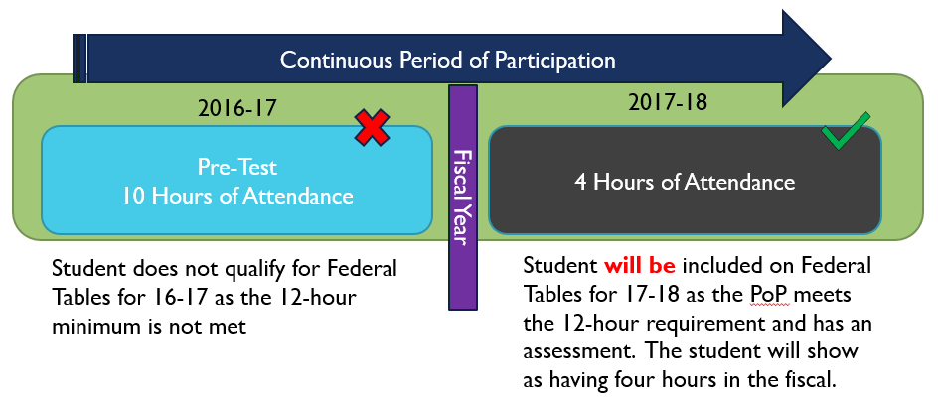
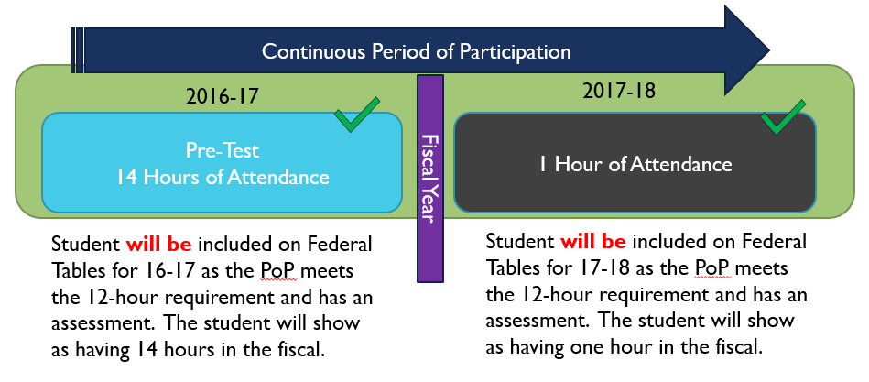
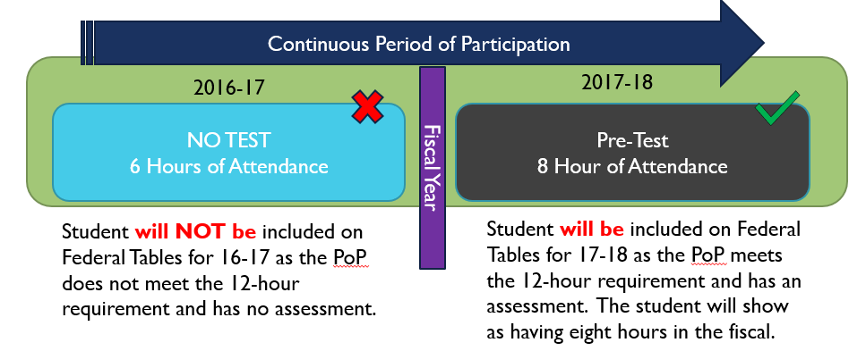
Valid Periods of Participation

Slide 47
Setting the entering efl for rollover students
The Entering EFL for students who roll from one fiscal year to the next is established by the last test(s) in the most recent battery.
Recalculating…
Yes, this is the logo for English League Football, but it looks really interesting

Slide 48
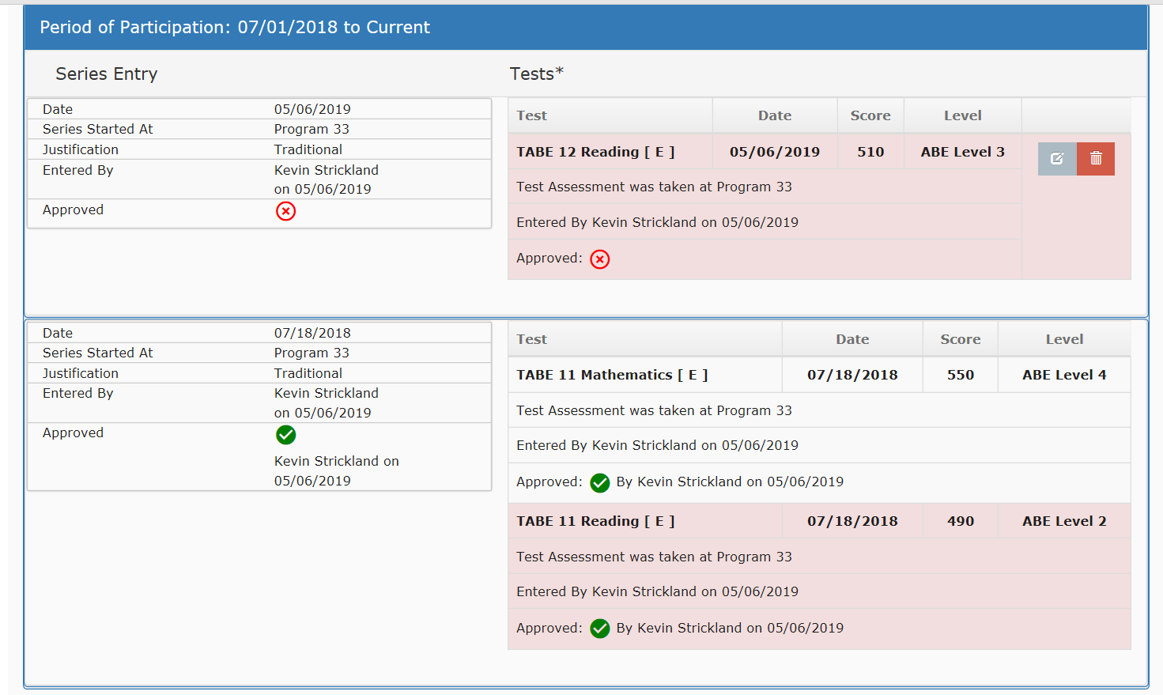
Setting the entering efl for rollover students
The Entering EFL for students who roll from one fiscal year to the next is established by the last test(s) in the most recent battery.
Example: Assuming the tests are approved and this PoP carries over into 19-20, the Entering EFL for that fiscal would be ABE Level 3 based on the 5/6/2019 Reading (Level 3) and the 7/18/2018 Math (Level 4).

Slide 49
Beware unlucky sevens
A student who ends the fiscal year at ESL Level 7 (designated in ADVANSYS as ESL Graduate – Not Eligible for Entry) , carries over to the next fiscal and is activated by attendance CANNOT APPEAR ON THE FEDERAL REPORTS!!
It is imperative for reporting purposes that students at ESL Level 7 be transitioned to ABE/ASE prior to the end of the fiscal.

Slide 50
DEALING WITH MULTIPLE PERIODS OF PARTICIPATION within the same fiscal year

Slide 51
Multiple Periods of Participation within a single Fiscal Year
Question:
What is the MAXIMUM number of Periods of Participation a student could conceivably have during a single fiscal year?
Hint: (It’s 3!)
According to hearsay, the percentage of students who have more than one Period of Participation in the same fiscal year is very small.
Some estimates have the number as low as 2%.

Slide 52
Measurable skills gains

Slide 53
Generating a Measurable Skills Gain by EFL
EXAMPLE 1:
POP ONE
PROGRAM A:
July 1 – September 17
POP TWO
Program B:
March 15 -
Pre-Test Assessments
TABE 9 Math – Level 3
TABE 9 Reading – Level 2
TABE 9 Language – Level 2
Pre-Test Assessments
TABE 10 Math – Level 3
TABE 10 Reading – Level 3
TABE 10 Language – Level 2
MSG for PoP One is obtained by Reading Level 3, PoP Two
Program B, PoP 2 is not obligated to follow the assessment pattern established by Program A

Slide 54
Generating a Measurable Skills Gain by EFL
EXAMPLE 2:
POP ONE
PROGRAM A:
July 1 – September 17
POP TWO
Program B:
March 15 -
Pre-Test Assessments
TABE 9 Math – Level 3
TABE 9 Reading – Level 2
TABE 9 Language – Level 2
Post-Test Assessments
TABE 10 Math – Level 2
TABE 10 Reading – Level 2
TABE 10 Language – Level 2
Pre-Test Assessments
TABE 9 Math – Level 3
TABE 9 Reading – Level 3
TABE 9 Language – Level 2
MSG for PoP One is obtained by Reading Level 3, PoP Two
Program B, PoP 2 is not obligated to follow the assessment pattern established by Program A, but Program A cannot be credited with a MSG unless Program B does so

Slide 55
Generating a Measurable Skills Gain by EFL
EXAMPLE 2A:
POP ONE
PROGRAM A:
July 1 – September 17
POP TWO
Program B:
March 15 -
Pre-Test Assessments
TABE 9 Math – Level 3
TABE 9 Reading – Level 2
TABE 9 Language – Level 2
Post-Test Assessments
TABE 10 Math – Level 2
TABE 10 Reading – Level 2
TABE 10 Language – Level 2
Pre-Test Assessments
TABE 9 Math – Level 3
TABE 9 Reading – Level 3
TABE 9 Language – Level 2
Post-Test Assessments
TABE 10 Math – Level 3
TABE 10 Reading – Level 3
TABE 10 Language – Level 3
MSG for PoP One is obtained by Reading Level 3, PoP Two
MSG PoP 2, Language
Program B, PoP 2 is NOT required to follow the assessment pattern established by Program A, PoP 1, but Program A cannot be credited with a MSG unless Program B does so

Slide 56
Generating a Measurable Skills Gain by EFL
EXAMPLE 4:
POP ONE
PROGRAM A:
July 1 – September 17
POP TWO
Program B:
March 15 -
Pre-Test Assessments
TABE 9 Math – Level 3
TABE 9 Reading – Level 2
No MSG from second PoP
Pre-Test Assessments
TABE 10 Math – Level 3
TABE 10 Reading – Level 2
TABE 10 Language – Level 2
Post-Test Assessments
TABE 9 Math – Level 3
TABE 9 Reading – Level 2
TABE 9Language – Level 3
Program B, PoP 2 is not obligated to follow the testing regimen established by Program A, PoP 1 but Program A cannot be credited with a MSG unless Program B does so
MSG in PoP Two in Language
QUESTIONS:
What is the student’s Entering EFL? (Level 2)
Does Program One show a MSG on Table 4? (No)

Slide 57
Generating a Measurable Skills Gain by EFL
EXAMPLE 2B:
Fiscal
Year
POP ONE 18-19
PROGRAM A:
July 1 – June 20
POP ONE 19-20
Program B:
September 18 -
Pre-Test Assessments
TABE 9 Math – Level 3
TABE 9 Reading – Level 2
TABE 9 Language – Level 2
Post-Test Assessments
TABE 10 Math – Level 2
TABE 10 Reading – Level 2
TABE 10 Language – Level 2
Pre-Test Assessments
TABE 9 Math – Level 3
TABE 9 Reading – Level 3
TABE 9 Language – Level 2
QUESTIONS:
Is PoP One 19-20 required to follow testing routine from 18-19? (No)
What is the student’s Entering EFL in 18-19? In 19-20? (Level 2, Level 2)

Slide 58
TABLE 4
Generating a Measurable Skills Gain by EFL
2017-18 Forward
EXAMPLE 2C:
Fiscal
Year
POP ONE 18-19
PROGRAM A:
July 1 –
POP ONE Rollover 19-20
Program B:
September 18 -
Pre-Test Assessments
TABE 9 Math – Level 3
TABE 9 Reading – Level 2
TABE 9 Language – Level 2
Post-Test Assessments
TABE 10 Math – Level 2
TABE 10 Reading – Level 2
TABE 10 Language – Level 2
Pre-Test Assessments
TABE 9 Math – Level 3
TABE 9 Reading – Level 3
TABE 9 Language – Level 2
QUESTIONS:
Is Program B required to follow testing routine from Program A? (Yes)
What is the student’s Entering EFL in 18-19? In 19-20? (Level 2, Level 2)

Slide 59
Generating a Measurable Skills Gain by EFL
EXAMPLE 5:
POP ONE
PROGRAM A:
July 1 – September 17
POP TWO
Program C:
March 15 -
Pre-Test Assessments
TABE 9 Math – Level 3
TABE 9 Reading – Level 2
POP ONE
PROGRAM B:
August 14 – October 4
No MSG from second PoP
Pre-Test Assessments
TABE 10 Math – Level 3
TABE 10 Reading – Level 2
TABE 10 Language – Level 2
Post-Test Assessments
TABE 9 Math – Level 3
TABE 9 Reading – Level 2
TABE 9Language – Level 3
Post-Test Assessments
TABE 10 Math – Level 3
TABE 10 Reading – Level 3
MSG PoP 1, Reading
MSG in PoP Two in Language
Program B, PoP 1 MUST follow the assessment pattern established by Program A
Program C, PoP 2 is not required to follow same test pattern

Slide 60
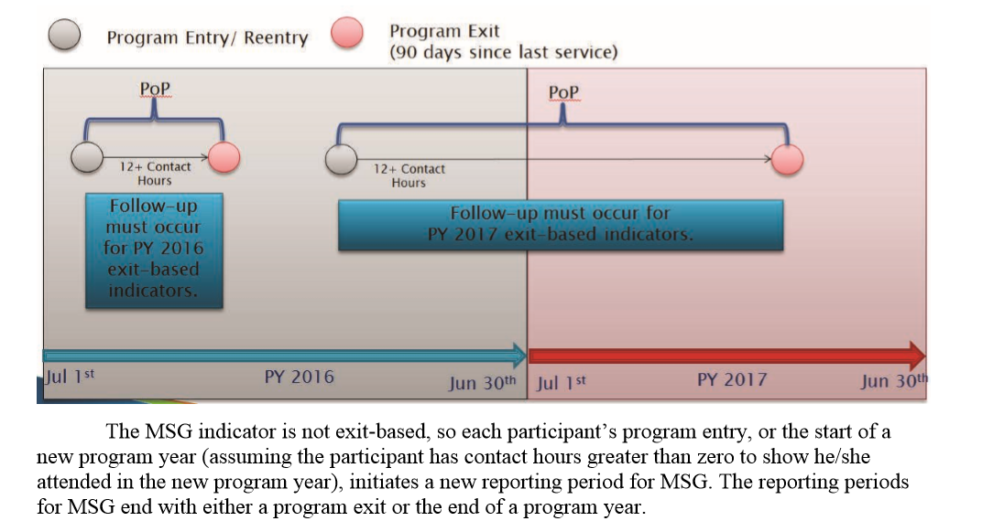
What about outcome follow-up?

Slide 61
What about outcome follow-up?
Simple rule for students who participated in only one program:
Follow-up must be conducted for EVERY valid PoP.
For students who participated in multiple programs over the course of a fiscal year, follow-up is a little more
Complicated.

Slide 62
What about outcome follow-up?
For students who participated in multiple programs over the course of a fiscal year, follow-up is based on the END OF THE PERIOD OF PARTICIPATION.
As an example if a student entered Program A in July and exited in September, but also entered Program B in August and remained active until March, both Program A and Program B would/could/should perform data matching and follow up in the appropriate collection periods based on that March date of exit.
That can potentially pose a problem for Program A which may not have seen the student since last contact in September.

Slide 63
What about outcome follow-up?
The key is cooperation.
Students who are simultaneously enrolled in multiple programs over the course of a single PoP will require those programs to cooperate on assessment entry and follow-up.

Slide 64
Questions?

